Slide 1

The battle of neighbourhoods
Recommending the best location for opening a new Park in Toronto
IBM Data Science Professional Certificate – Capstone Project
Presented by :
Ms. EZZAKRAOUI Meriem
Date : 09th June 2020
Notes:
© Copyright Showeet.com – Free PowerPoint Templates

Slide 2
Summary
Introduction
Data Science Methodology
From Problem to Approach and From Approach to Analytics
From Requirement to Collection
From Understanding to Preparation
From Modeling to Evaluation
Conclusion
Notes:
© Copyright Showeet.com – Free PowerPoint Templates

Slide 3
Introduction
Toronto is an international center of business, finance, arts, and culture, and is recognized as one of the most multicultural and cosmopolitan cities in the world. So a group of investors is looking to open a new Park in Toronto, and asking for recommendation about the best Location where implementing the new Park?
This project seeks to explore data insights using Data Science Methodology 101 to identify the best Districts in Toronto that may be under-served by the number of existing Parks, and what are the factors that lead to such insights like Population Density. The audience for this project is investors having a vested interest in responding to market demand by making investment and operations decisions based on data insights.
Notes:
© Copyright Showeet.com – Free PowerPoint Templates

Slide 4
Data Science Methodology
Data Science Methodology is a system of methodology used in a particular area of study or activity to address a question in hands. This methodology aimed at increasing the use of Data Mining over a wide variety of business applications and industries.
1. From Problem to Approach and From Approach to Analytics
Data Science Methodology 101
Begins with spending the time to seek clarification supporting the goal. Before even starting collecting data, objectives and goals need to be defined.
DS M101 is iterative and never ends. It starts from Business understanding to Analytic Approach.
2. From Requirement to Collection
3. From Understanding to Preparation
4. From Understanding to Preparation
DS Methodology is like cooking, the Data Science should seek for all ingredients required, collect them, understand them and prepare them to meet the desired outcome.

Slide 5
Data Science Methodology
From Problem to Approach and From Approach to Analytics
A
B
The group of investors is looking to choose the better place to implement a new Park in Toronto which is an international center of business, and is recognized as one of the most multicultural and cosmopolitan cities in the world.
So our task is building recommendations of some districts in Toronto where this group can open a new Park using Clustering since we don’t have any labeled data on which we can learn our machine.
C
We need to segment our District using Population and Number of existing Parks here which is an unsupervised Approach to create segments with groups of objects that are similar to other objects in a cluster, and dissimilar to objects in other clusters.
Doing that, we will be able to interpret Clusters and deduct the one with a Max Population and Minimum existing Parks.
D

Slide 6
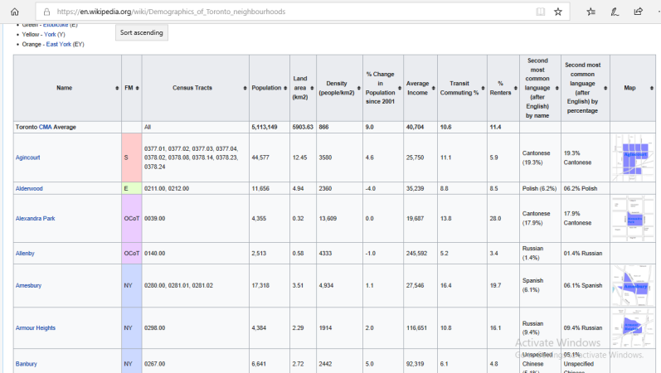
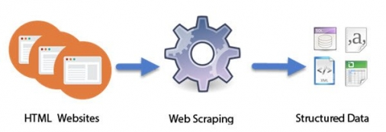
Data Science Methodology
2. From Requirement to Collection
As we should use Open Source Data to get Districts in Toronto and use population and the number of existing Parks around, are the main criteria for this first iteration, we will start by collecting this data using:
Scrapping from Wikipedia to get Demographic Data and Focus on Population Only in this iteration:
URL: https://en.wikipedia.org/wiki/Demographics_of_Toronto_neighbourhoods
Geocoder to geo-locate Districts of Toronto to be used in Foursquare API
Foursquare API to get all geographic information about Neighbourhoods and explore Toronto Districts to get all venues and specially the existing Parks.

Slide 7
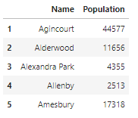
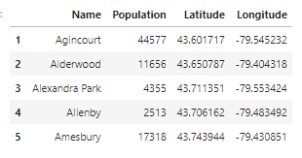
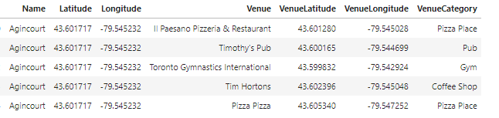
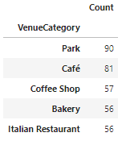
Data Science Methodology
3. From Understanding to Preparation
After collecting Demographic Data from Wikipedia (Fig-1), geo-locate them using the Name of Districts (Fig-2), and get all Neighbors around these Districts in a radius of 500 (Fig-3), we got these 5-Top Categories of Neighbors (Fig-4).
Fig1 - Demographic Data from Wikipedia
Fig2 - District Coordinates
Fig3 - District Neighbors
Fig4 - 5-Top Categories

Slide 8
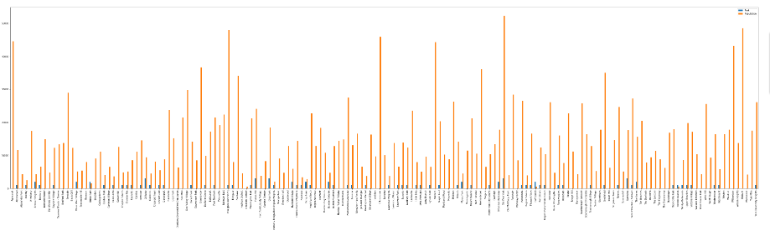
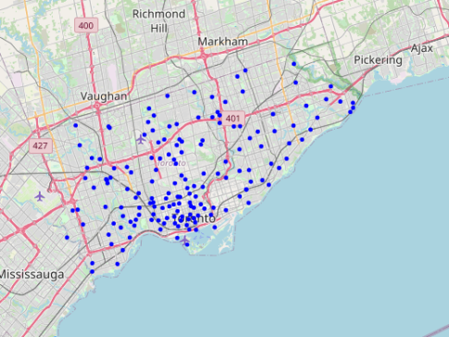
Data Science Methodology
The orange color represents Population in a District while Blue Color represent Number of existing Parks around this District in a radius of 500 (this number range from 0 Park to 3 Parks around).
3. From Understanding to Preparation
We only keep Park Category as Neighbors to answer what demanded by Investors, and then we got cleaned DataSet of 163 District ready for making some Features like: Number of existing Parks.
The orange color represents Population in a District while Blue Color represent Number of existing Parks around this District in a radius of 500 (this number range from 0 Park to 3 Parks around
We can get here an idea about some potential in some Districts with an important Population density, but no Park around.
We can also see the repartition of these Districts in this Map using Folium:

Slide 9
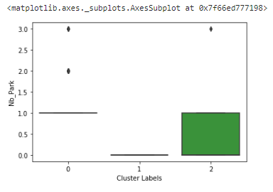
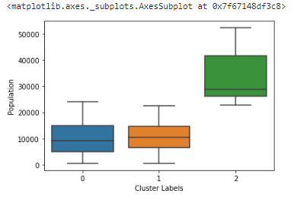
In this case we need to segment our District using K-Means Clustering with 2 Inputs: Population and Number of existing Parks.
After running the Model we get 3 Clusters in this iteration:
Data Science Methodology
The orange color represents Population in a District while Blue Color represent Number of existing Parks around this District in a radius of 500 (this number range from 0 Park to 3 Parks around).
4. From Modeling to Evaluation
In this case we need to segment our District using K-Means Clustering with 2 Inputs: Population and Number of existing Parks.
After running the Model we got 3 Clusters in this iteration:
Interpretation: The Cluster-2 Have maximum values of Population and at most 1 Park.

Slide 10
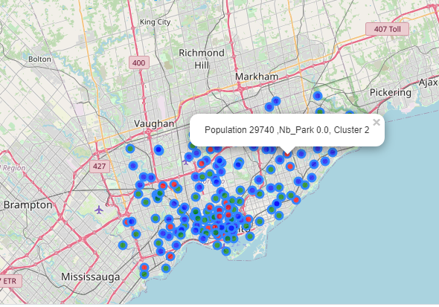
In this case we need to segment our District using K-Means Clustering with 2 Inputs: Population and Number of existing Parks.
After running the Model we get 3 Clusters in this iteration:
Data Science Methodology
The orange color represents Population in a District while Blue Color represent Number of existing Parks around this District in a radius of 500 (this number range from 0 Park to 3 Parks around).
4. From Modeling to Evaluation
We can also visual our Clusters in the Map using Folium:

Slide 11
Conclusion
Using some criteria such as Population and Number of existing Parks Neighbors to choose the right District where we can implement Our Park in this iteration we got these first results:
- Districts where the best Place should be implemented based on the Population are those in Cluster-2 with Maximum Population and Minimum of Parks.
- Districts where there is already a high competition, to be eliminated in a next iteration with more criteria.
By adding more criteria and more data we could filter these districts in Cluster-2 again in order to get the best District to implement the new Park.
Notes:
© Copyright Showeet.com – Free PowerPoint Templates

Slide 12
Thank you for your Reviewing
Notes:
© Copyright Showeet.com – Free PowerPoint Templates

